Slide 1
Hibernate Framework
(Advanced Course)
Developed by Binh Nguyen Feb 18, 2009
Presenter: Binh Nguyen

Slide 2
Objectives
This course provides attendees a deeply knowledge of Hibernate techniques and share some tips or experiences.

Slide 3
Contents
Advance Hibernate mapping
Hibernate Query Language (HQL)
Object States
Hibernate Session and Session Cache
Lazy Loading in Hibernate
Tips or troubles shooting experiences
References
Q&A

Slide 4
1. Advance Hibernate mapping
1.1 Mapping Document Example:
<hibernate-mapping> <class name="example.Team" table="teams"> <id name="id" column="team_id" type="long" unsaved-value="0"> <generator class="hilo"/> </id> <property name="name" column="team_name" type="string" length="15" not-null="true"/> <property name="city" column="city" type="string" length="15" not-null="true"/> <set name="players" cascade="all" inverse="true" lazy="true"> <key column="team_id"/> <one-to-many class="example.Player"/> </set> </class> </hibernate-mapping>

Slide 5
1. Advance Hibernate mapping
Some commonly used generators in hibernate:
Generator | Description
identity | It supports identity columns in DB2, MySQL, MS SQL Server, Sybase and HypersonicSQL. The returned identifier is of type long, short or int.
sequence | The sequence generator uses a sequence in DB2, PostgreSQL, Oracle, SAP DB, McKoi or a generator in Interbase. The returned identifier is of type long, short or int
hilo | The hilo generator uses a hi/lo algorithm to efficiently generate identifiers of type long, short or int, given a table and column (by default hibernate_unique_key and next_hi respectively) as a source of hi values.
assigned | lets the application to assign an identifier to the object before save() is called. This is the default strategy if no <generator> element is specified.
native | It picks identity, sequence or hilo depending upon the capabilities of the underlying database.
foreign | uses the identifier of another associated object. Usually used in conjunction with a <one-to-one> primary key association.
…

Slide 6
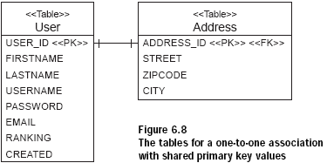
1. Advance Hibernate mapping
1.2 Mapping entity associations: One-to-one
Table schema:

Slide 7
1. Advance Hibernate mapping
1.2 Mapping entity associations: One-to-one (cont.)
Hibernate mapping: Address mapping
<class name="Address" table="ADDRESS"> <id name="id" column="ADDRESS_ID"> <generator class="foreign"> <param name="property">user</param> </generator> </id> ... <one-to-one name="user" class="User" constrained="true"/> </class>
constrained="true“: tells Hibernate that there is a foreign key constraint on the primary key of ADDRESS that refers to the primary key of USER.

Slide 8
1. Advance Hibernate mapping
1.2 Mapping entity associations: One-to-one (cont.)
Hibernate mapping: User mapping
… <one-to-one name="address" class="Address" cascade="save-update"/> …
Scenario:
Address address = user.getAddress();
//Or
User user = address.getUser();

Slide 9
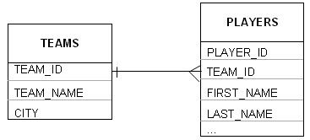
1. Advance Hibernate mapping
1.3 Mapping entity associations: One-to-many
Table schema:

Slide 10
1. Advance Hibernate mapping
1.3 Mapping entity associations: One-to-many (cont.)
Hibernate mapping: Teams mapping
<hibernate-mapping> <class name="example.Team" table="teams"> <id name="id" column="team_id" type="long" unsaved-value="0"> <generator class="hilo"/> </id> <property name="name" column="team_name" type="string" length="15" not-null="true"/> <set name="players" cascade="all" inverse="true" lazy="true"> <key column="team_id"/> <one-to-many class="example.Player"/> </set> … </class> </hibernate-mapping>
Scenario: Set<Player> players = team.getPlayers();
// Return a collection of Player instances

Slide 11
1. Advance Hibernate mapping
1.4 Mapping entity associations: Many-to-one
Table schema:

Slide 12
1. Advance Hibernate mapping
1.4 Mapping entity associations: Many-to-one (cont.)
Hibernate mapping: Player mapping
<hibernate-mapping> <class name="example.Player" table="players"> <id name="id" column="player_id" type="long" unsaved-value="null"> <generator class="hilo"/> </id> <property name="firstName" column="first_name" type="string" length="12" not-null="true"/> <property name="lastName" column="last_name" type="string" length="15" not-null="true"/> … <many-to-one name="team" class="example.Team" column="team_id"/> </class> </hibernate-mapping>
Scenario: Team team = player.getTeam();
// Return corresponding Team instance

Slide 13
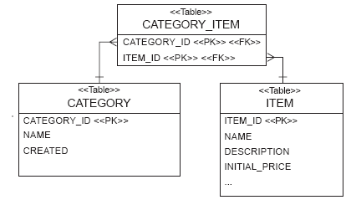
1. Advance Hibernate mapping
1.5 Mapping entity associations: Many-to-many
Table schema:

Slide 14
1. Advance Hibernate mapping
1.5 Mapping entity associations: Many-to-many (cont.)
Hibernate mapping: Item mapping
<hibernate-mapping> <class name="Item" table="ITEM"> ... <set name="categories" table="CATEGORY_ITEM" lazy="true" inverse="true" cascade="save-update"> <key column="ITEM_ID"/> <many-to-many class="Category" column="CATEGORY_ID"/> </set> </class> </hibernate-mapping>

Slide 15
1. Advance Hibernate mapping
1.5 Mapping entity associations: Many-to-many (cont.)
Hibernate mapping: Category mapping
<hibernate-mapping> <class name="Category" table="CATEGORY"> ... <set name="items" table="CATEGORY_ITEM" lazy="true" cascade="save-update"> <key column="CATEGORY_ID"/> <many-to-many class="Item" column="ITEM_ID"/> </set> </class> </hibernate-mapping>
Scenario: cat.getItems().add(item);
item.getCategories().add(category);

Slide 16
2. Hibernate Query Language (HQL)
Looks very much like SQL
To retrieve objects from the database
HQL is fully object-oriented
Example:
Query q = session.createQuery("from User u where u.firstname = :fname"); q.setString("fname", "Max"); List result = q.list();

Slide 17
2. Hibernate Query Language (HQL)
2.1 The “from” clause
from example.Player
from example.Player as p
from example.Player p
from example.Player p, example.Team t

Slide 18
2. Hibernate Query Language (HQL)
2.2 Associations and joins
The supported join types:
  inner join
  left outer join
  right outer join
Join conditions using the HQL “with” keyword
from example.Player p inner join p.team t with t.id != 1
Two forms of association joining: implicit and explicit
from example.Player p where p.team.name like '%abc%‘ //implicit

Slide 19
2. Hibernate Query Language (HQL)
2.3 The “select” clause
The select clause picks which objects and properties to return in the query result set:
Select p from example.Player p where p.team.name like '%abc%'
Return multiple objects or properties as an array of type Object[ ]:
Select p.id as id, p.firstName as fn, p.lastName as ln from example.Player p where p.team.name like '%abc%'
Queries may return an actual type-safe Java object:
Select new example.PlayerViewUtil(p) from example.Player p where p.team.name like '%abc%'

Slide 20
2. Hibernate Query Language (HQL)
2.4 Aggregate functions
The supported aggregate functions are
  avg(...), sum(...), min(...), max(...)
  count(*)
  count(...), count(distinct ...), count(all...)
The distinct and all keywords may be used and have the same semantics as in SQL
Select count(p) from example.Player p where p.team.name like '%abc%'

Slide 21
2. Hibernate Query Language (HQL)
2.5 The “where” clause
The “=“ operator may be used to compare not only properties, but also instances:
Select p from example.Player p where p.team.name = ‘team1’
Select p from example.Player p where p.team = :team

Slide 22
2. Hibernate Query Language (HQL)
2.5 The “where” clause (cont.)
Binding parameters: JDBC-style Positional parameters “?”
String sqlString = “Select p from example.Player p where p.team.name = ?”; Query q = getSession().createQuery(sqlString); q.setParameter(0, “abc”);
Binding parameters: Named parameters
Team team = (Team) session.get(Team.class, new Long(12345)); String sqlString = “Select p from example.Player p where p.team = :team”; Query q = session.createQuery(sqlString); q.setParameter(“team”, team);

Slide 23
2. Hibernate Query Language (HQL)
2.5 The “where” clause (cont.)
We may test the size of a collection with the special property size, or the special size() function.
Select t from example.Team t where t.players.size > 10
Select t from example.Team t where size(t.players) > 10

Slide 24
2. Hibernate Query Language (HQL)
2.6 “Order by” and “Group by” clause
Select p from example.Player p where p.team.name = ‘team1’ order by p.firstName asc, p.lastName desc
Select t.id, t.name from example.Team t join t.players p where p.team.name = ‘team1’ group by t.id, t.name having count(p) > 100

Slide 25
2. Hibernate Query Language (HQL)
2.7 Subqueries
Hibernate supports subqueries within queries. A sub query must be surrounded by parentheses.
Note that HQL subqueries may occur only in the select or where clauses (not from clause).
Select t from example.Team t where 10 < ( select count(p) from t.players p where p.firstName like “%abc%” )

Slide 26
3. Object States
Object states: each state represents model object relationship with Hibernate Session. There are 3 states:
  Transient: new object, not stored in DB or Id =0 and no associated session
  Persisted: object presents a row in DB (opened session)
  Detached: object presents a row in DB but session closed

Slide 27
3. Object States
Example:
SessionFactory sessionFactory = new Configuration().configure(). buildSessionFactory(); session = sessionFactory.openSession(); Player player = new Player(); //transient object player.setFirstName(“a”); player.setLastName(“b”); session.save(player);// persisted object /////////////////////////////////// int teamID = 1234; Team team = (Team) session.get(Team.class, new Long(teamID));//persisted session.delete(team);//detached object

Slide 28
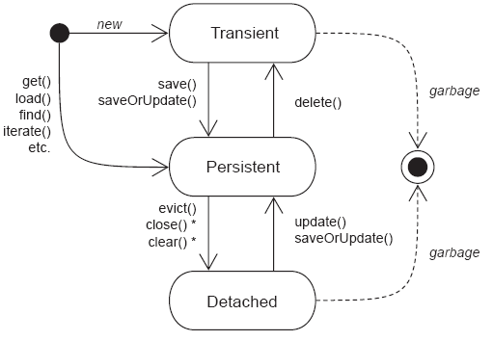
3. Object States

Slide 29
4. Hibernate Session and Session Cache
4.1 Hibernate Session
Get way/ connection to DB
All queries are executed in a session
Begin unit of work → open a session
End unit of work → close session
Close session: synchronize in-memory session state into DB

Slide 30
4. Hibernate Session and Session Cache
4.1 Hibernate Session (cont.)
SaveOrUpdate function:
  Not put data into DB
  Update session in-memory state
  Transient object: associate/attach object to current session (get new Id)
  Persisted object: do nothing (already in session)
  Detached object: re-associate/re-attach object to current session

Slide 31
4. Hibernate Session and Session Cache
4.2 Session Scope: short conversations
To begin a unit of work you open a Session. To end a unit of work you close a Session.
Most common programming model: session-per-request
Request
Response
S1
T1

Slide 32
4. Hibernate Session and Session Cache
4.2 Session Scope (cont.): long conversations model
Multi dialogs/pages
Many requests/responses
session-per-request-with-detached-objects pattern:
  Persisted objects → detached from session when closed (user think-time)
  Detached objects → re-attached to new session when modified

Slide 33
4. Hibernate Session and Session Cache
4.2 Session Scope (cont.): long conversations model
Conversation
Detached Objects
saveOrUpdate()
merge()
Request
Response
Request
Response
S1
S2
T1
T2
myDetail.do
Show page
Save page
redirect page

Slide 34
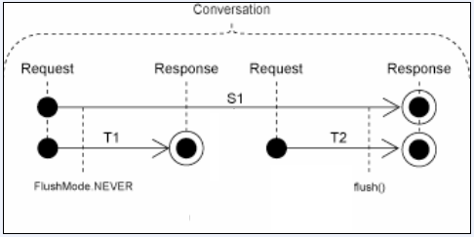
4. Hibernate Session and Session Cache
4.2 Session Scope (cont.): long conversations model
session-per-conversation pattern:

Slide 35
4. Hibernate Session and Session Cache
4.3 Hibernate Session Cache
To improve performance
Avoid the overhead of retrieving objects from the database each time.
Object will be cached in Session cache when:
  Pass object to: save(), update(),saveOrUpdate()
  Access object with: load(),find(),filter(),iterate()
Session.flush(): synchronize object state in Session cache to Database.

Slide 36
4. Hibernate Session and Session Cache
4.3 Hibernate Session Cache (cont.)
Session cache management:
  Session.contains(): to see whether an object is contained in the Session cache.
  Session.evict(): to evict objects from the cache.
  Session.clear(): to clear all the objects from the Session cache.

Slide 37
5. Lazy Loading in Hibernate
Only load data when needed( accessed)
Prevent loading unnecessary information
Improve performance
<hibernate-mapping> <class name="Category" table="CATEGORY"> ... <set name="items" table="CATEGORY_ITEM" lazy="true" > <key column="CATEGORY_ID"/> <many-to-many class="Item" column="ITEM_ID"/> </set> </class> </hibernate-mapping>

Slide 38
6. Tips/troubles shooting experiences
6.1 Lazy Loading Exception
If you close the session and try to access an uninitialized collection, Hibernate throws a runtime exception.
Session session = sessions.openSession(); Transaction tx = session.beginTransaction(); Category cat = (Category) session.get(Category.class, id); tx.commit(); session.close(); Iterator iter = cat.getItems().iterator(); // throws exception

Slide 39
6. Tips/troubles shooting experiences
6.1 Lazy Loading Exception (cont.)
cat: detached object
Request
Response
Request
Response
S1
S2
cat=getCategory()
cat.getItems() → Exception
Fix2 = Hibernate.initialize( cat.getItems())
Fix1 = saveOrUpdate(cat)

Slide 40
6. Tips/troubles shooting experiences
6.2 NonUniqueObjectException
Message: a different object with the same identifier value was already associated with the session:
Note: Only one object instant in a Hibernate Session

Slide 41
6. Tips/troubles shooting experiences
6.2 NonUniqueObjectException (cont.)
P1: detached object
Request
Response
Request
Response
S1
S2
P1=getPerson()
P2=getPerson()
saveOrUpdate(P1) → Exception

Slide 42
6. Tips/troubles shooting experiences
6.2 NonUniqueObjectException (cont.)
Fix1: use merge(P1) instead of saveOrUpdate(P1) → P1 will replace P2. So, it is not good solution.
Fix2: set modified data into P2 and then saveOrUpdate(P2) instead of P1.

Slide 43
References
http://www.hibernate.org
http://www.roseindia.net/hibernate/index.shtml
http://www.hibernate.org/hib_docs/reference/en/html/index.html

Slide 44
Q&A

Slide 45
Thank you !!!

